Slide 1
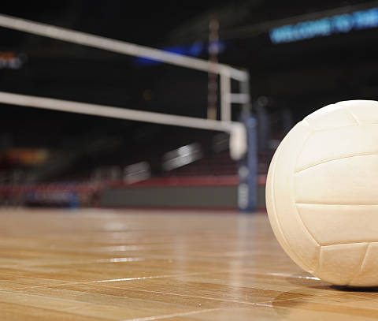
Volleyball
(PE.7.C.2.3, PE.7.C.2.1, PE.7.M.1.6, PE.7.M.1.6, PE.7.C.2.6, PE.7.M.1.6, PE.7.C.2.6)

Slide 2
Learning Objectives
By the end of this lesson, students will be able to:
Describe how the game of volleyball is played.
Identify the players and positions.
Demonstrate how to perform an overhead pass.
Demonstrate how to perform a forearm pass.

Slide 3
How to Play Volleyball
(PE.7.C.2.1)

Slide 4
What is Volleyball?
Volleyball is a sport played by 2 teams on a playing court divided by a net.
Each team has 6 players.
Players use their hands to send the ball back and forth over the net, trying to make the ball touch the court within the opponents’ playing area before it can be returned.
Watch this video to learn about volleyball: https://youtu.be/kVzojOj5_Zg

Slide 5
Points, Sets and Match
A game is played to 25 points.
A team must win by 2 points and is called a set.
A match is 3 out of 5 sets.

Slide 6
Serve
The server must stand anywhere behind the end line on his/her side of the court prior to the serve.
The ball may be served underhand or overhand.
The player who serves is in the right back position.
Watch this video to see how to serve a volleyball https://youtu.be/Qv1mA1s8p9Y

Slide 7
Rotation
The teams will rotate clockwise each time they win the serve.

Slide 8
Rotation Video
Watch this video to discover how to rotate in volleyball: https://youtu.be/mqC-E9h2vH8

Slide 9
Basic Rules
Each team may only hit the ball 3 times on its side before the ball must pass over the net.
A point is scored every time a ball is not returned properly into the opponent’s court, this is called rally scoring. Thus, both serving and receiving teams can score points.
If the ball hits the line it is considered, in bounds or good.

Slide 10
Players and Positions
(PE.7.M.1.6)

Slide 11
Player and Positions
Setters – player who “sets” the ball with an “overhead pass” for a teammate to hit, the setter normally runs the offense
Hitter - the spiker or attacker
Outside hitter - A left or right-front attacker normally taking an approach which starts from outside the court
Libero - defensive specialists, designated for back row only, and wear a different colored jersey. The libero may serve for one player she is substituting for per game.
Blocking - A defensive play by one or more players meant to deflect a spiked ball back into the hitter’s court. To block, move your body in front of the hitter, keep arms in front, straight, palms facing the ball.

Slide 12
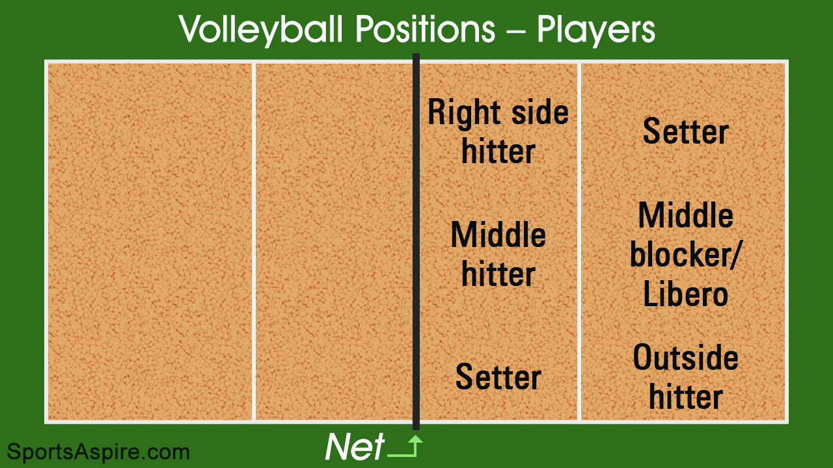
Player and Positions Diagram

Slide 13
Overhead Pass
(PE.7.M.1.6, PE.7.C.2.6)

Slide 14
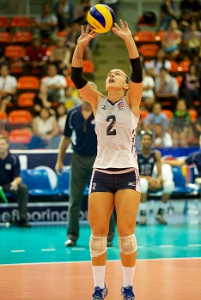
What is an Overhead Pass?
An overhead pass is a ball handling skill used to direct the ball to the target by contacting the ball with both hands.
The ball is played up overhead using a setting type motion.

Slide 15
How to Perform and Overhead Pass
Watch this video on how to perform an overhead pass
https://youtu.be/GX49gLs6piU

Slide 16
Forearm (Bump) Pass
(PE.7.M.1.6, PE.7.C.2.6)

Slide 17
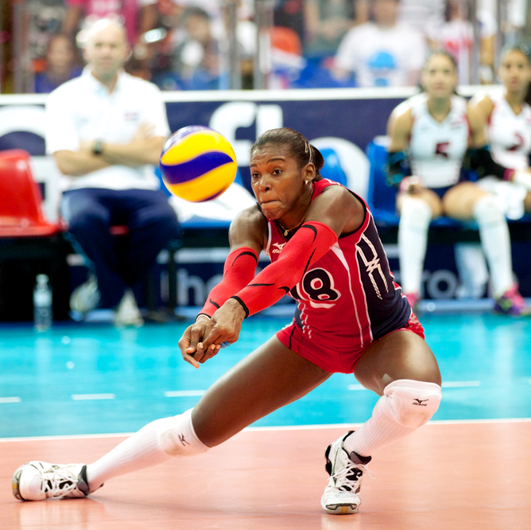
What is a Forearm (Bump) Pass
Stand in ready position. Place the knuckles of one hand into the palm of the other hand. Thumbs should be side by side with knuckles up, resting on top of the index fingers.
Rotate your forearms forward so that the elbows almost touch. This will form a flat surface between the wrists and elbows. This is the intended contact spot. As the ball comes toward you, move to get under it by bending your knees. Watch the ball until contact.
Keep the arms together and extended, with the elbows straight and locked
Lift with the legs and follow through with your arms in the direction of the flight of the ball.
Do NOT swing the arms up, but rather shrug the shoulders upward.

Slide 18
How to Perform a Forearm (Bump) Pass
Watch this video on how to perform a forearm pass. https://youtu.be/siDVtYyRG_M

